Slide 1
AWS SERVICES
Practical Experience
Name: Md.Haneef
Roll no: 20A31A05H9

Slide 2
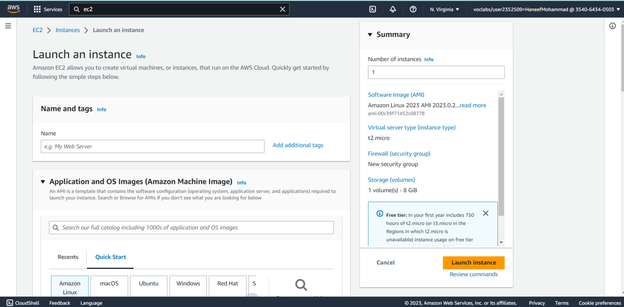
EC2 INSTANCE:
At first we have to search for ec2 of aws management console
click on instances and click launch instances
launch instance option will create a new instance
When we click on launch instance the image look like this

Slide 3
Give a name for your EC2 instance
Select Microsoft windows server 2022 which is free tier eligible
Choose t2 micro as a instance type
Create a new key pair and give a name for the key pair you should download pem file for the windows.
You should also be ready with downloading putty file in your system
Create a security group for your instance
Click on launch instance to create instance
Your instance will be created
In the EC2 Console, choose Instances and choose the instance you want to connect to
From the Actions menu choose get windows password
Next to key pair path choose Browse.
Browse to and select the labsuser.pem file you downloaded earlier.

Slide 4
Next to key pair path choose Browse.
Browse to and select the labsuser.pem file you downloaded earlier
Use a Remote Desktop Protocol (RDP) client to connect to the desktop of the EC2 instance

Slide 5
Virtual Private Cloud
At first, we have to create a VPC for that
Search for vpc and choose vpc to open the vpc console
Click on create vpc
Under Name tag auto-generation, change value from project to lab
Check ipv4 CIDR BLOCK set to 10.0.0.0/16
Number of availability zones should be 1
Number of private and public subnets should be 1
Change the NAD gateway to 1AZ
Click on create VPC.

Slide 6
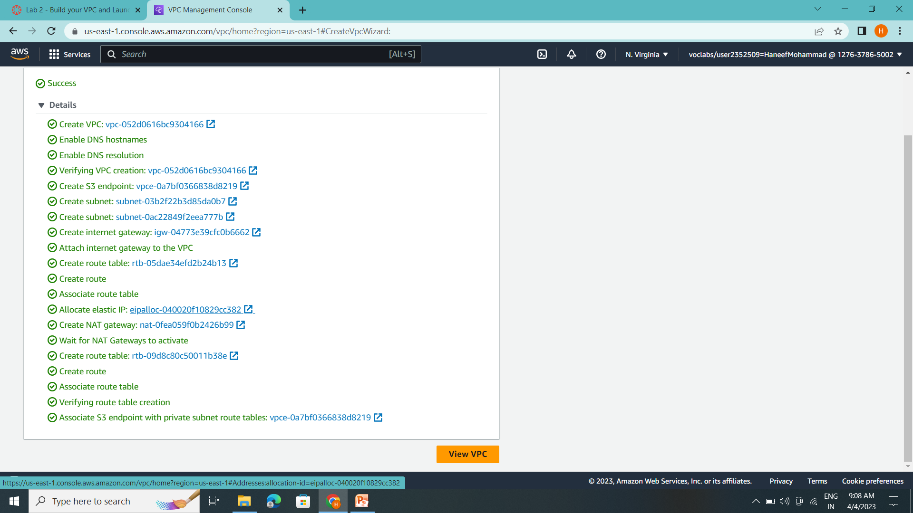
Check whether all are done
And click view vpc

Slide 7
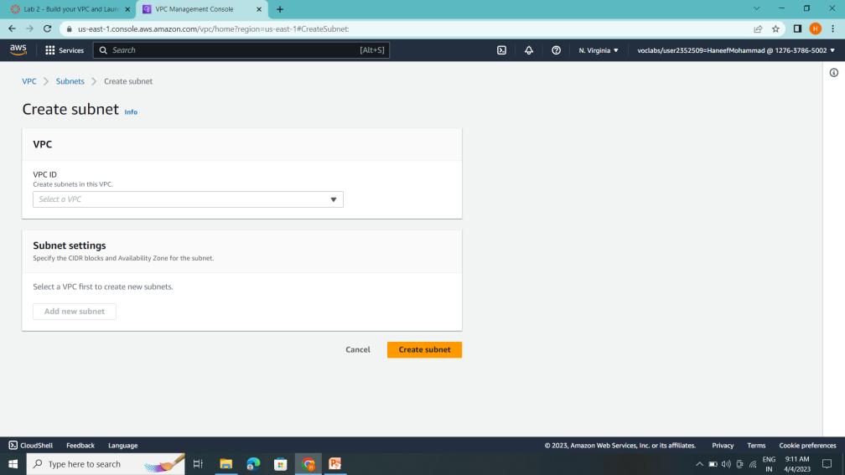
Choose create subnet
VPC ID: lab-vpc (select from the menu).
Subnet name: lab-subnet-public2
Availability Zone: Select the second Availability Zone (for example, us-east-1b)
IPv4 CIDR block: 10.0.2.0/24

Slide 8
Create subnet
In the left navigation pane, choose Route tables.
Select the lab-rtb-private1-us-east-1a route table.
In the lower pane, choose the Routes tab.
Note that Destination 0.0.0.0/0 is set to Target nat-xxxxxxxx. This means that traffic destined for the internet (0.0.0.0/0) will be sent to the NAT Gateway. The NAT Gateway will then forward the traffic to the internet.
Choose save associations

Slide 9
Choose Create security group and then configure:
Security group name: Web Security Group
Description: Enable HTTP access
VPC: choose the X to remove the currently selected VPC, then from the drop down list choose lab-vpc
In the Inbound rules pane, choose Add rule
Configure the following settings:
Type: HTTP
Source: Anywhere-IPv4
Description: Permit web request
Create security group

Slide 10
From the Launch instance menu choose Launch ec2 instance.
Name the instance:
Give it the name Web Server 1
From the Key pair name menu, select vockey.
Configure the Network settings:
Next to Network settings, choose Edit, then configure:
Network: lab-vpc
Subnet: lab-subnet-public2 (not Private!)
Auto-assign public IP: Enable
Next, you will configure the instance to use the Web Security Group that you created earlier.
Under Firewall (security groups), choose Select existing security group.
For Common security groups, select Web Security Group.

Slide 11
Choose View all instances
Wait until Web Server 1 shows 2/2 checks passed in the Status check column.
Select Web Server 1.
Copy the Public IPv4 DNS value shown in the Details tab at the bottom of the page.
Open a new web browser tab, paste the Public DNS value and press Enter.
You should see a web page displaying the AWS logo and instance meta-data values.

